Slide 1
Invasive Quagga and Zebra Mussels in the west
Southern California Water Dialogue
June 25, 2008

Slide 2
Quagga Mussels

Slide 3
Quagga Mussels
Live quagga mussels discovered January 6, 2007 in Lake Mead
First known established population of invasive quagga mussels in the Western United States
Between January and September 2007, quagga mussels spread to four Western States
In 2008, zebra mussels were discovered in San Justo Reservoir, Northern California and in El Pueblo Reservoir, Colorado

Slide 4
Consequences of Unmanaged Quagga/Zebra Mussel Infestations
The safety of drinking water is not affected but can:
Alter the aquatic ecology of lakes and rivers
Clog intakes and raw water conveyance systems
Reduce the recreational and aesthetic value of lakes and beaches
Alter or destroy fish habitats
Render lakes more susceptible to deleterious algae blooms

Slide 5
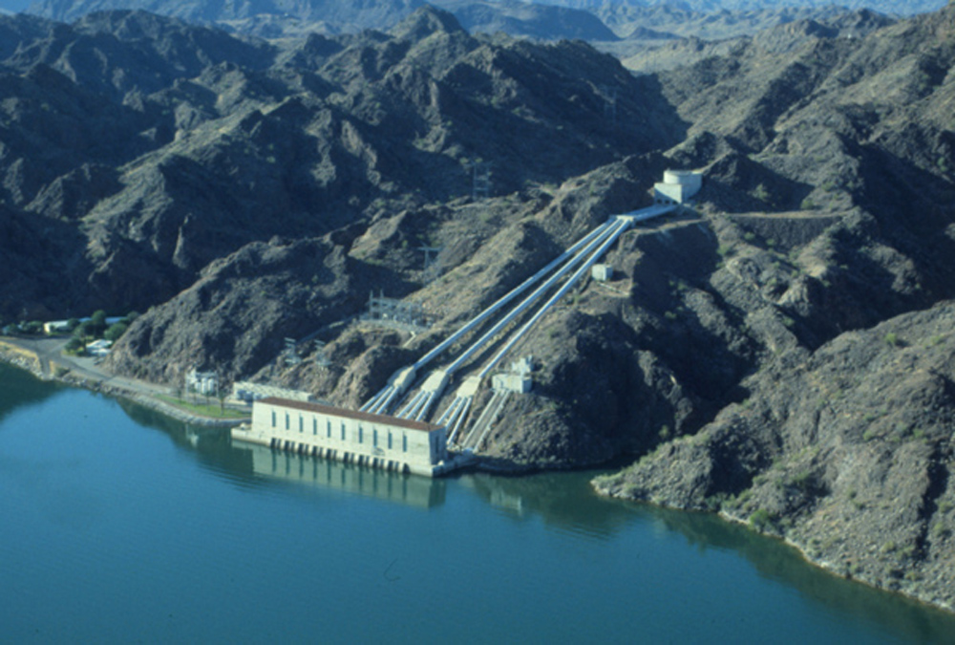
Colorado River Adult Quagga Detections
Metropolitan’s Intake at Lake Havasu, Feb 2007
At Intake: very low density, 1 or 2 adults per square meter

Slide 6
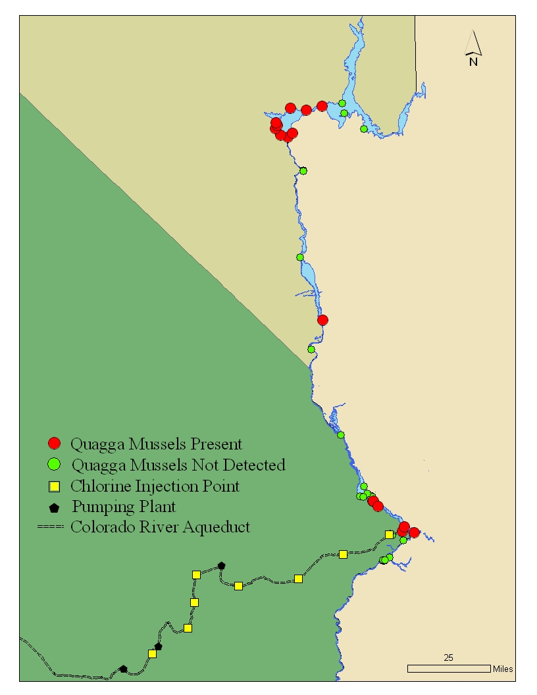
February 2007 Survey of Colorado River; Colorado River Aqueduct and MWD Reservoirs
Lake Mead
Lake Mohave
Not Detected:
In Lakes in Southern California
Lake Havasu
Intake
Iron PP
Eagle PP

Slide 7
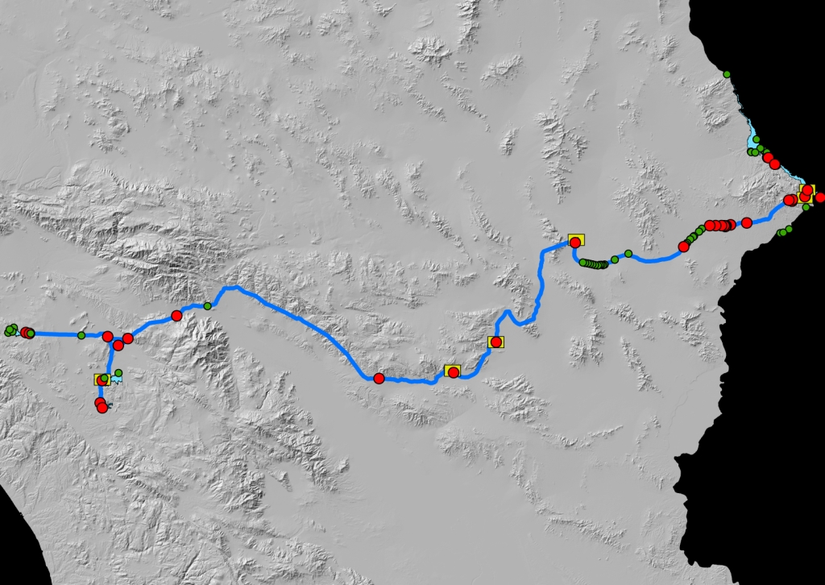
The Rapid Spread
Colorado River Aqueduct
July, 2007
Present
Absent

Slide 8
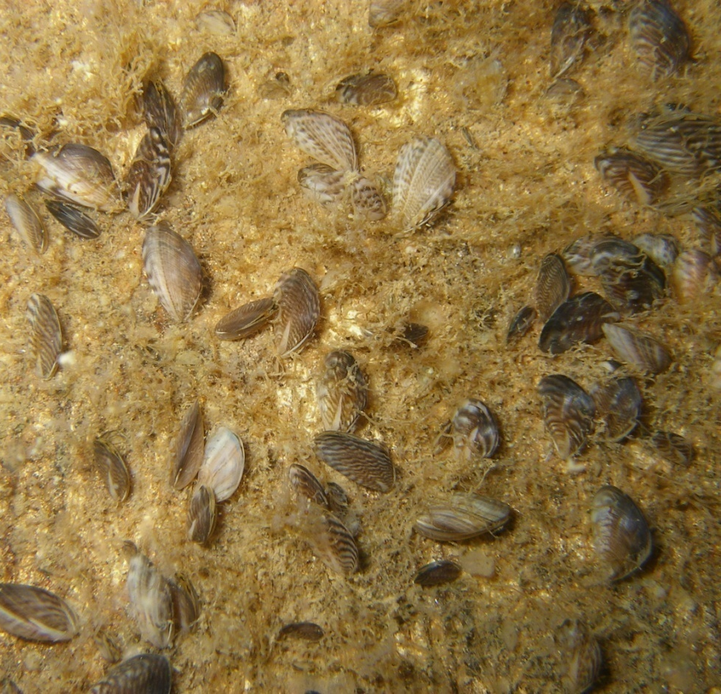
Infrastructure Colonization:

Slide 9
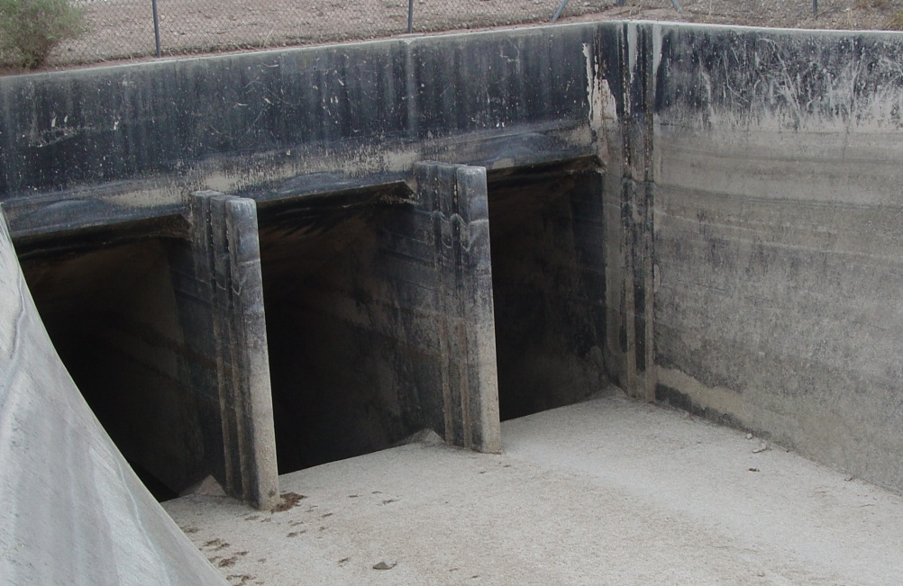
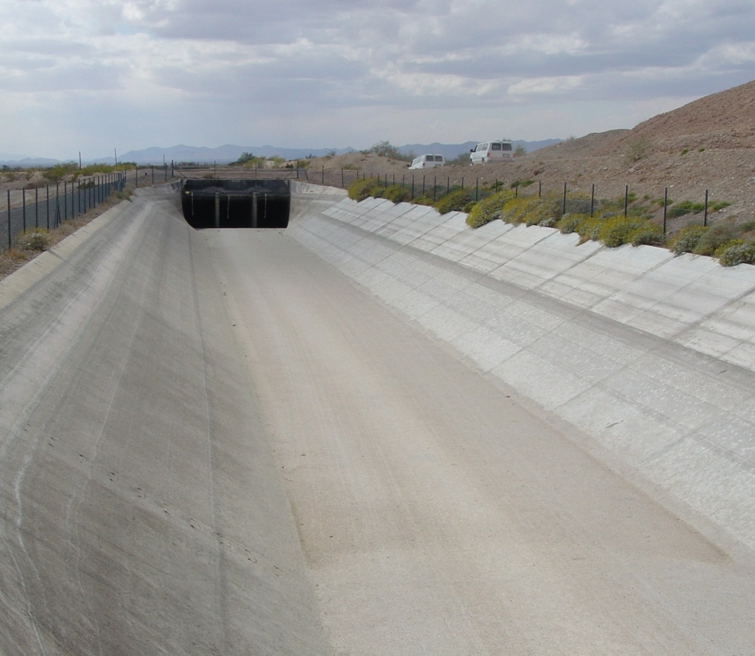
Rapid Actions Needed
March and July 2007 CRA Shutdowns:
Major portions of the aqueduct canals were dried out
68 of the 144 siphons in the CRA were de-watered and inspected.

Slide 10
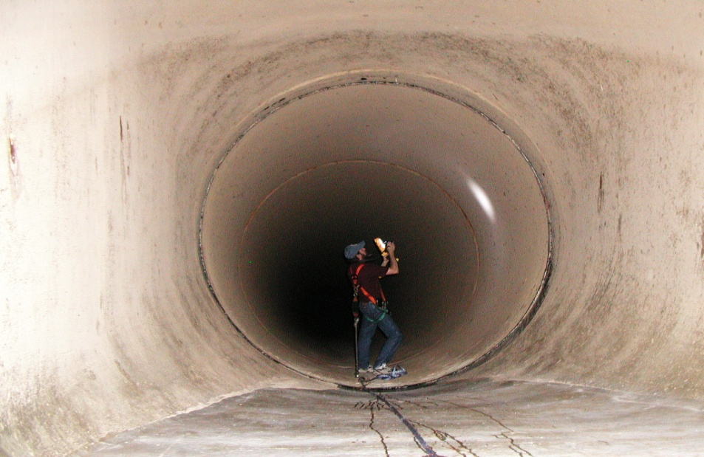
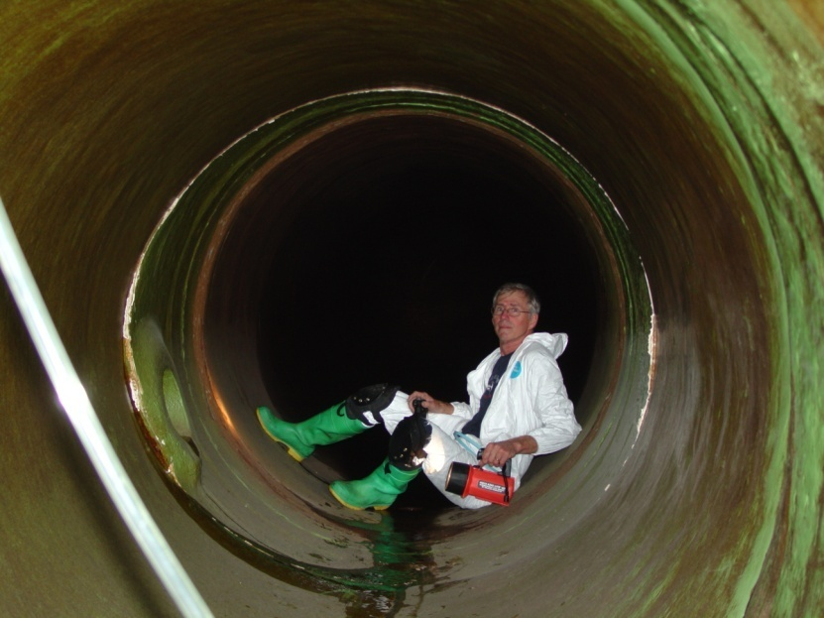
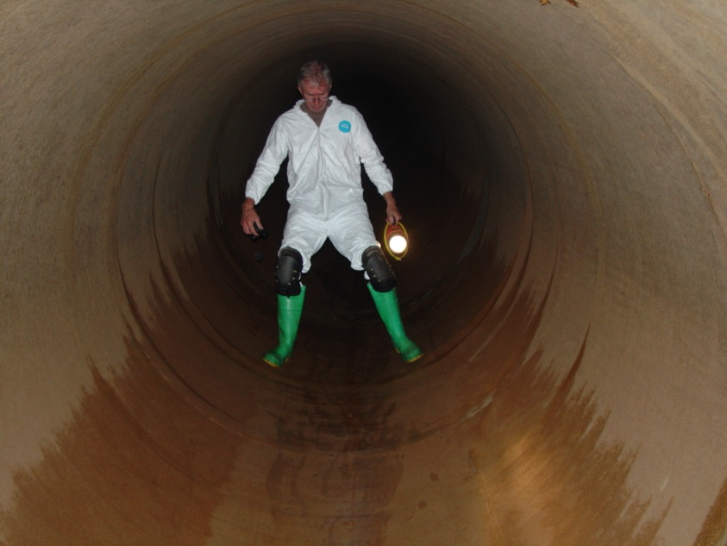
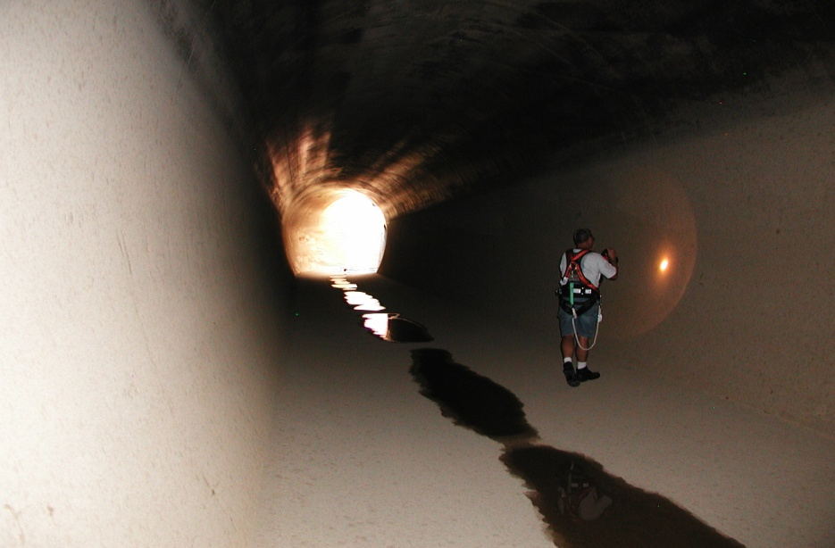
Facility Inspections:

Slide 11
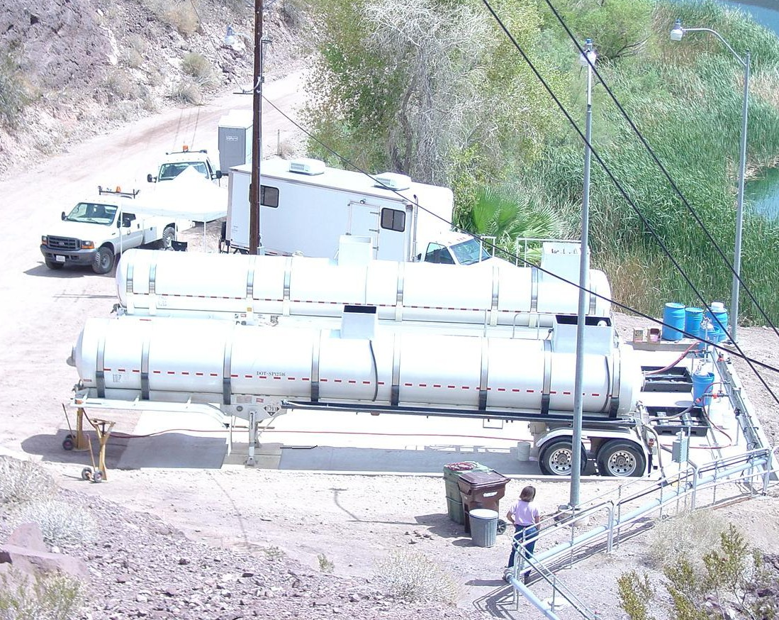
Facilities Upgrades:

Slide 12
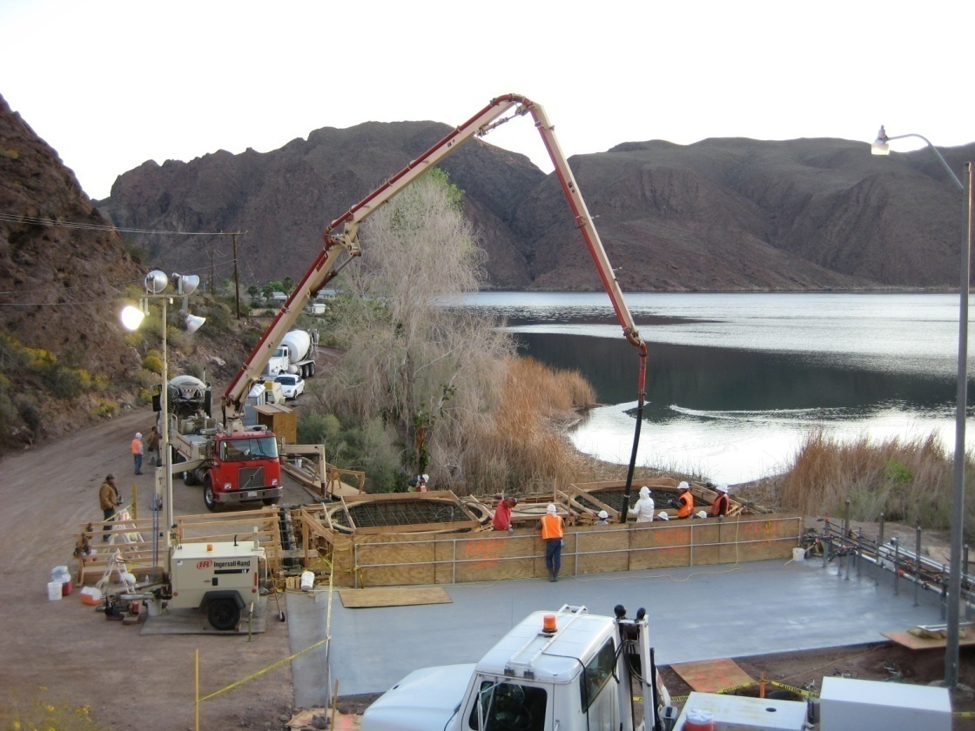
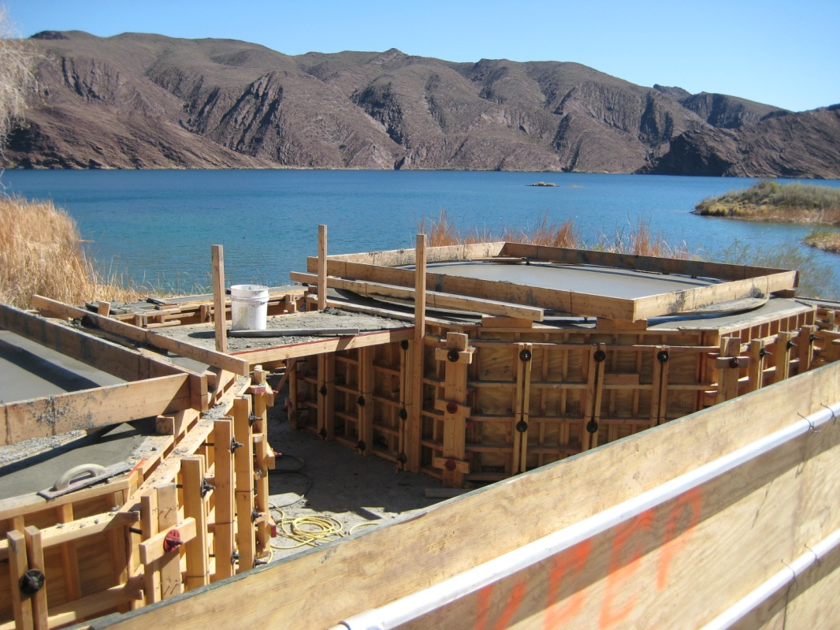
Copper Basin Interim Chlorination System
Notes:
Project includes:
1,000 ft of chlorine line
800 ft of service and potable water lines
800 ft power supply line extension
New injection facility
The chlorine line and the utility lines (water and power) are coming from different locations. So a common trench is not feasible.

Slide 13
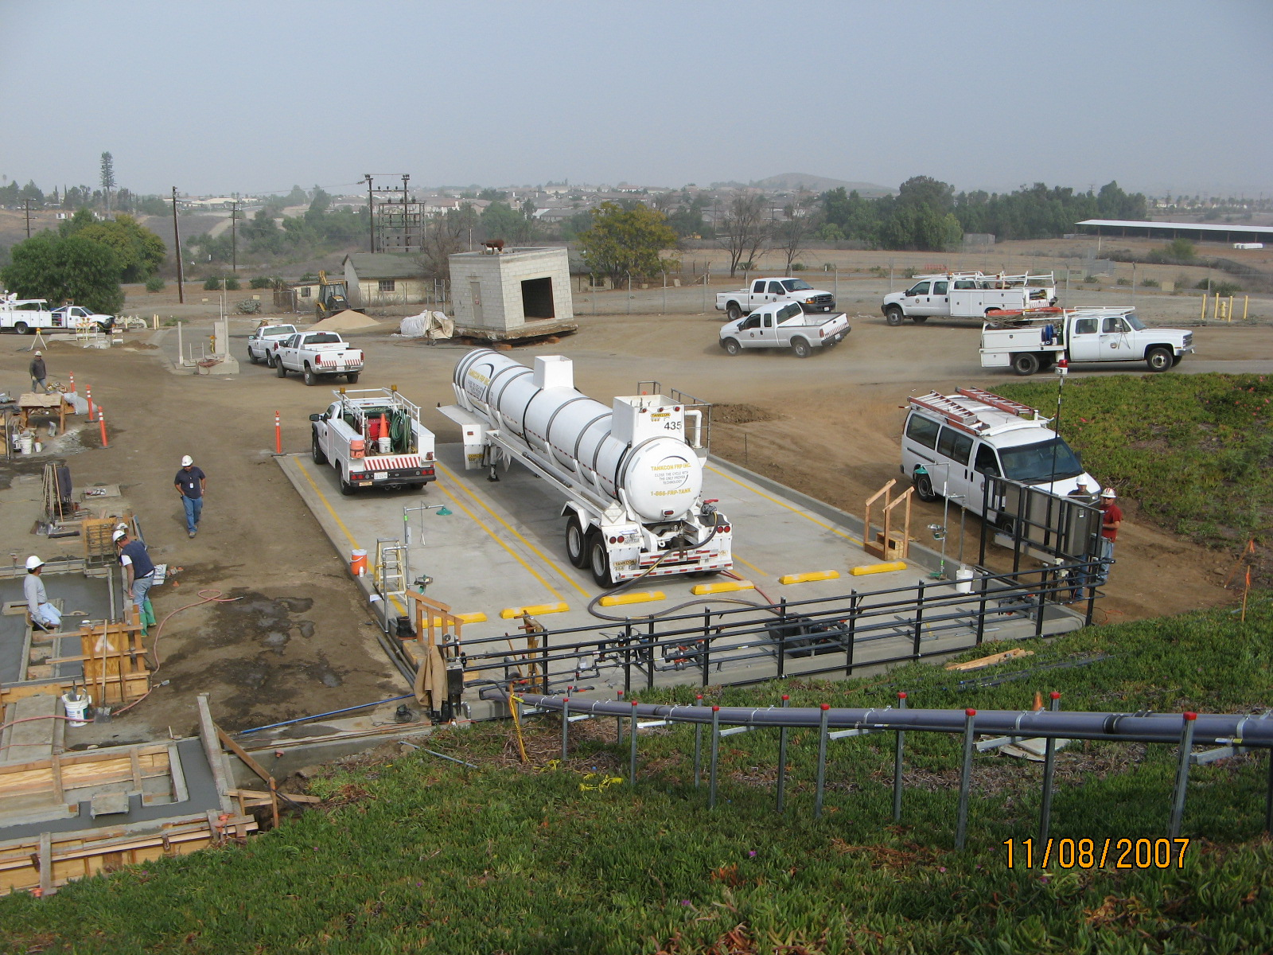
Lake Mathews Interim Chlorination Facility

Slide 14
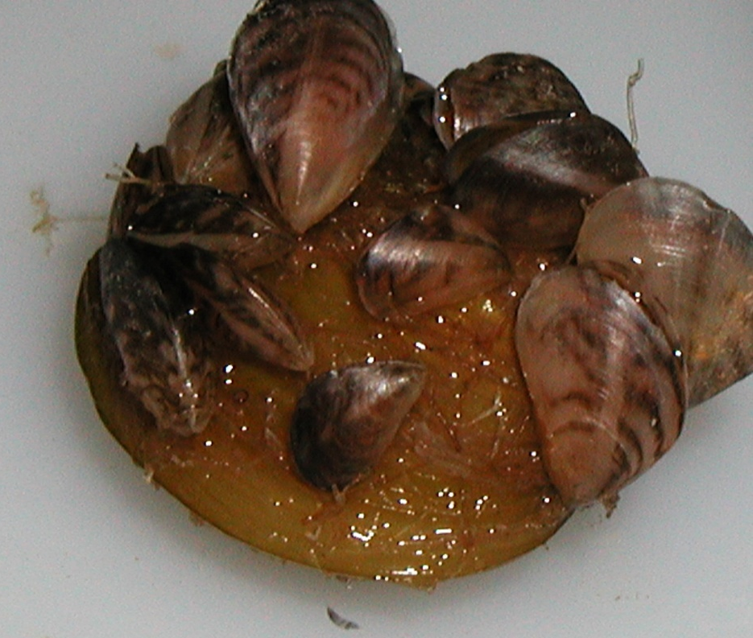
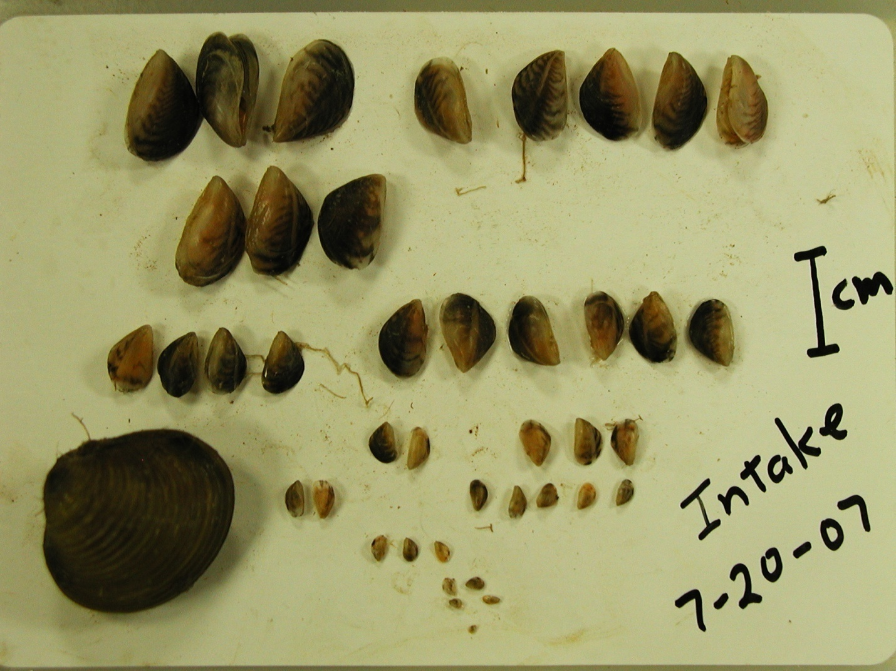
41 mussels on one Corbicula shell
Size classes equal spawning events?

Slide 15
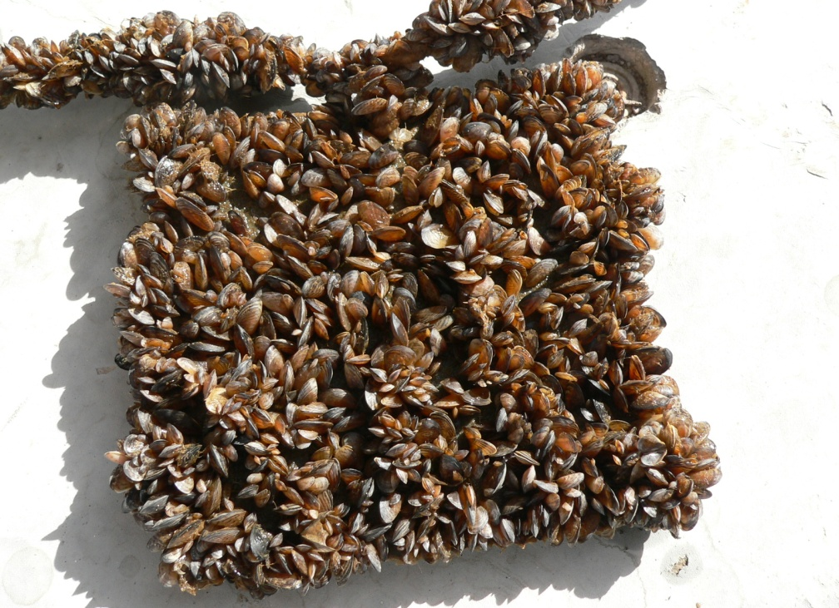
Fast Increase in Population Density Parker Dam, Lake Havasu
August/07
November/07

Slide 16
Whitsett Intake, January 2008

Slide 17
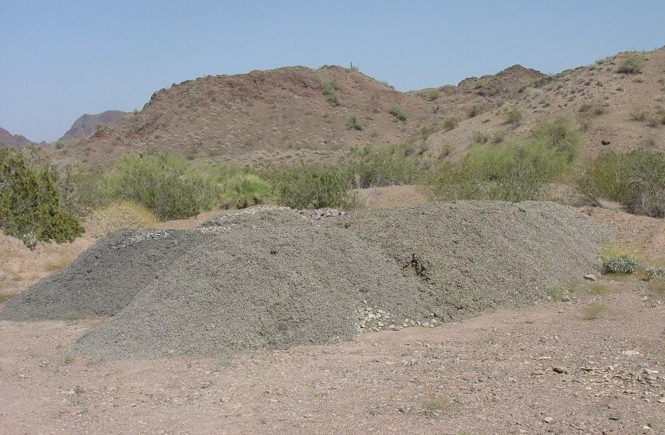
Removal of Quaggas

Slide 19
Federal Support Needed:
The faster life cycle of mussels in the West impacts prevention, response, mitigation and frequency of actions
Financial support needed for affected agencies
Development of region-specific plans
Research to address faster growth rate and control methods that meet new drinking water and environmental regulations.

Slide 20
Metropolitan’s Quagga Mussel Control Program
Phase I: February 2007-August 2007
Initial assessment and equipment procurement
Phase II: Started September 2007
Interim chlorination systems
Design of permanent disinfection systems
Isolation barriers along the Colorado River Aqueduct
Collaboration with federal, state and local agencies
AwwaRF Quagga Workshop April 3-4
Phase III
Cost mitigation strategies
Notes:
O&M Activities to include R&D and OE purchases
Phase III activities include long term mitigation strategies; cost minimization strategies and effective survey program

Slide 21
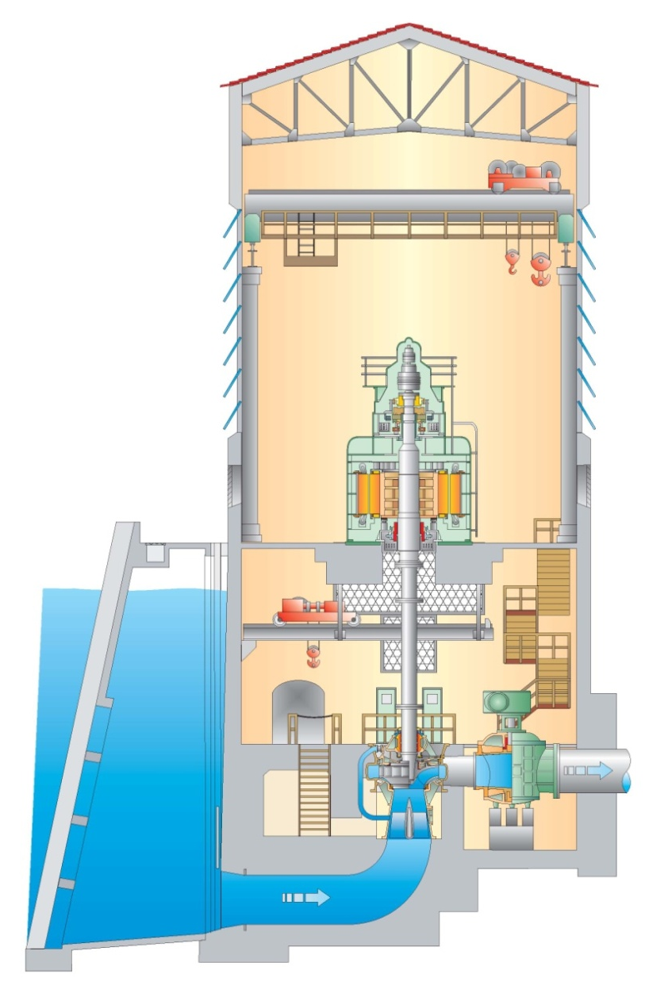
Isolation Barriers at Whitsett Intake
Two Alternatives:
Hypalon Rubber Gate
Metal Plates

Slide 22
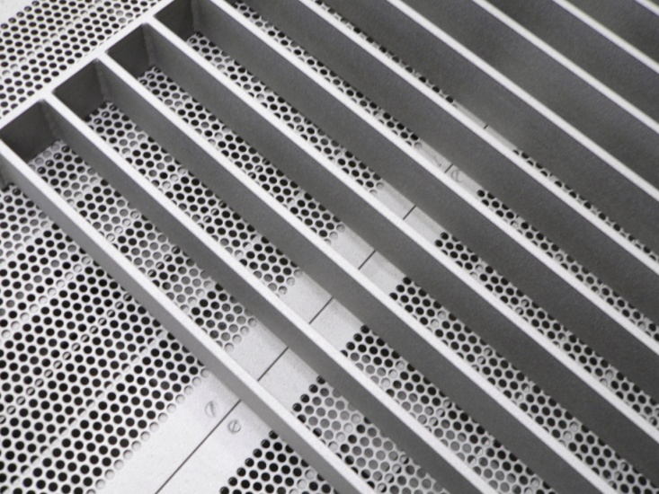
Testing on Whitsett Trash Racks
Active Coating
Slippery Coating
Depth
Control
1-m² Galvanized Steel Surrogate Trash Racks
Notes:
Engineering’s Corrosion Team plans to conduct side-by-side testing of an active surface coating (Luminore Copper Coating) and a slippery-surface coating (International Coatings Intersleek 900). Nine mini-trash racks were constructed; 3 control, 3 active coating; and 3 slippery surface coating. Racks will be evaluated for 3 months at 3 different depths (20 ft, 40 ft, and 60 ft). If 3-month test successful, samples will evaluated for up to one year. If unsuccessful, racks will be removed and another coating will be tested.

Slide 23
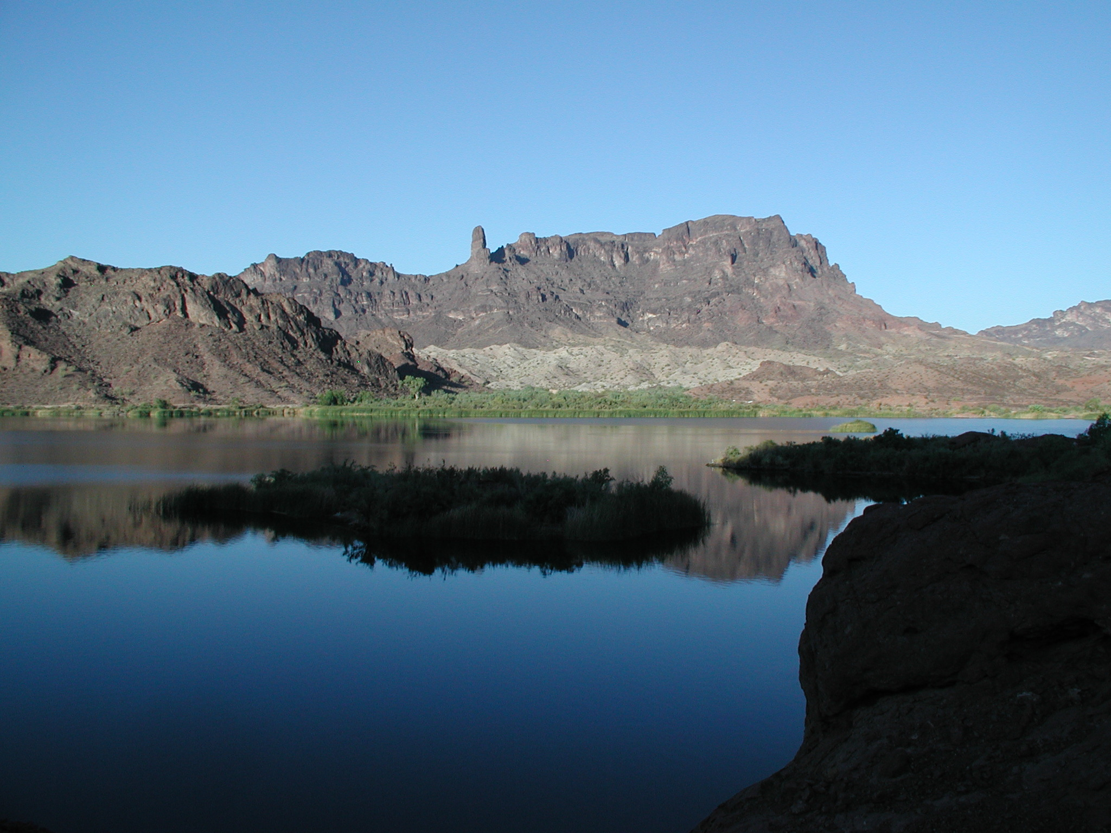
Copper Basin, March 2008

Slide 24
CRA March Shutdown
Surveillance of aqueduct for quagga mussel populations
Desiccation of mussels
Assessment of control measures effectiveness
Aqueduct maintenance activities

Slide 25
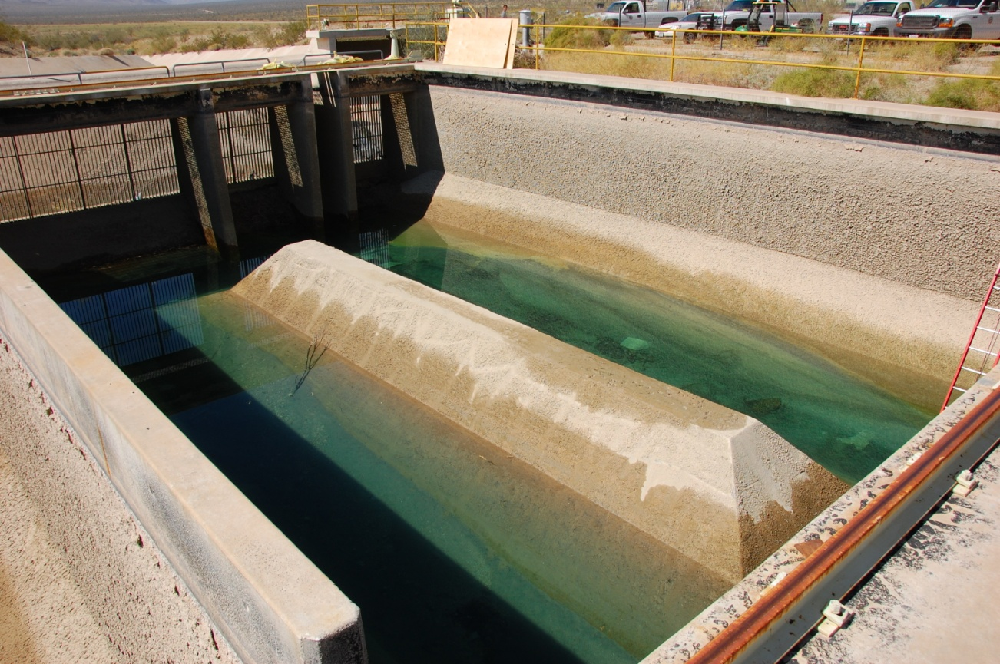
Surveillance of the CRA
CRA Sand Traps harbor small populations of quagga mussels

Slide 26
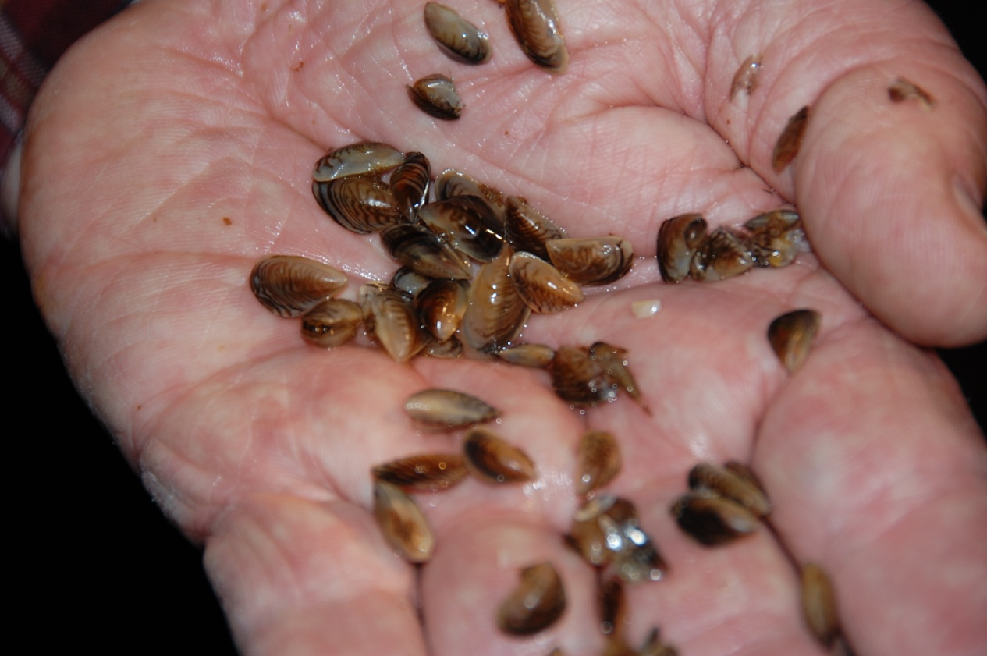
Tunnels, Adits and Siphons
East Portal Adit

Slide 27
Quagga Mussel Control in Lakes and Reservoirs
Objective:
Develop a control approach based on:
1) Control of natural processes
2) Manage flows to our advantage
3) Integrate algae control with quagga control
4) Cautiously use exploratory approaches

Slide 28
Overall Approach
Limnological Principles
Mussel Behavior
Control Options
+
+
Implementation Plan
Lake
Mathews
Lake Skinner
Copper Basin
Gene
Wash
Diamond Valley Lake

Slide 29
Range of Control Options for Lake Management
Oxygen Deprivation | Nutrient Reduction
Desiccation | Manage Hydrology
Disrupt Reproductive Cycle | Temperature Control
Predation | Physical Removals
Chemical Treatments

Slide 30
Lake Mathews

Slide 31
Lake Mathews Second Outlet Tower

Slide 32
Quagga Mussel Control: Scenario 1, Step 1
Outlet Tower
Oxygen mg/L
0
5
10
15
Monitor for Taste & Odor Production
Summer
Aerators
Monitor Oxygen Level

Slide 33
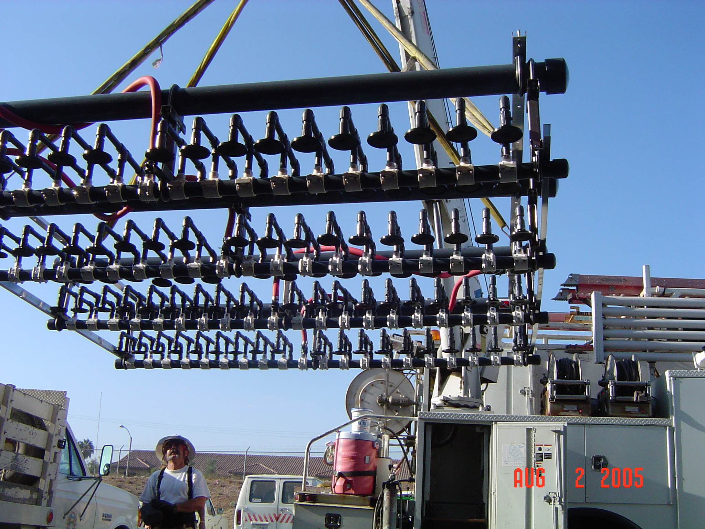
Aeration Grid

Slide 34
Quagga Mussel Control: Scenario 1, Step 2
Outlet Tower
Desiccate Upper Portion of Lake
Increase Oxygen Level
Aerators

Slide 35
Next Steps
AwwaRF’s multi-agency quagga mussel workshop
Report and funding opportunities
Develop new control strategies for lakes and reservoirs
AB 1683 compliance
Colorado River Aqueduct shutdowns
November 2008 and February 2009
Notes:
Add slide /notes on next steps:
Discuss CRA shutdown in March - quagga inspection
March 10 – 19, 2008
Quagga mussel driven aqueduct inspection
New Copper Basin chlorine feed line
Multi-agency quagga mussel workshop – sponsor, attendees, etc.
April 2008
Develop new control strategies
AB1683 compliance

